Slide 1



OMNIZENON
405 Found
Arpit Singh Gautam
Raghav Kapoor

Slide 2

Problem Statement
In this contemporary age, we often see organizations struggle to keep their workforce motivated and keen on working.
OMNIZENON is a productivity-boosting application to combat this issue
OMNIZENON

Slide 3


Our Solution
Productivity boost requires HAPPY employees. Employees need acknowledgment of their work, which can be done using incentives to make them happy and provide motivation for the future.
Our application helps to determine who deserves the most raises, promotions, and other benefits.
We achieve this through an algorithm that takes respective inputs and calculates their overall performance.
OMNIZENON

Slide 4
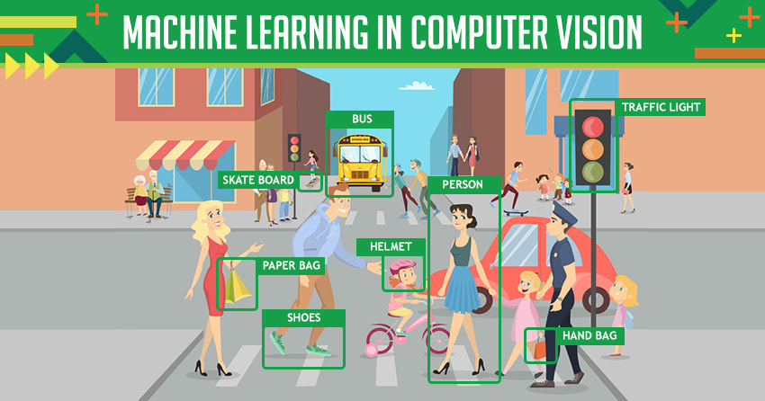
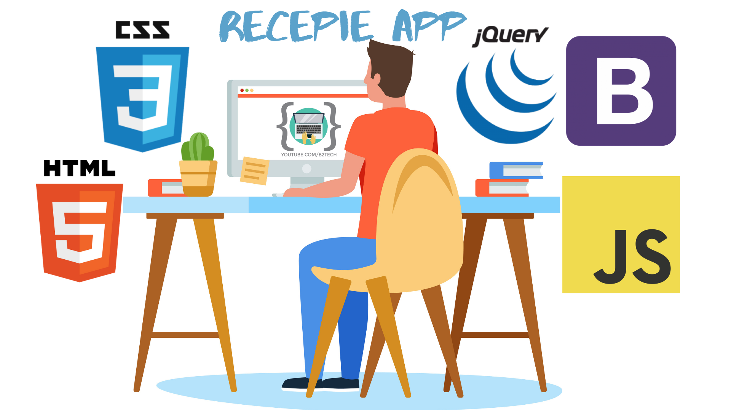

Tools and Technologies Used
Face Recognition System Using Machine Learning
Python
Front-end (HTML CSS JavaScript )
Front-end Frameworks(Bootstrap)
Back-end Framework(Django)
OMNIZENON

Slide 5
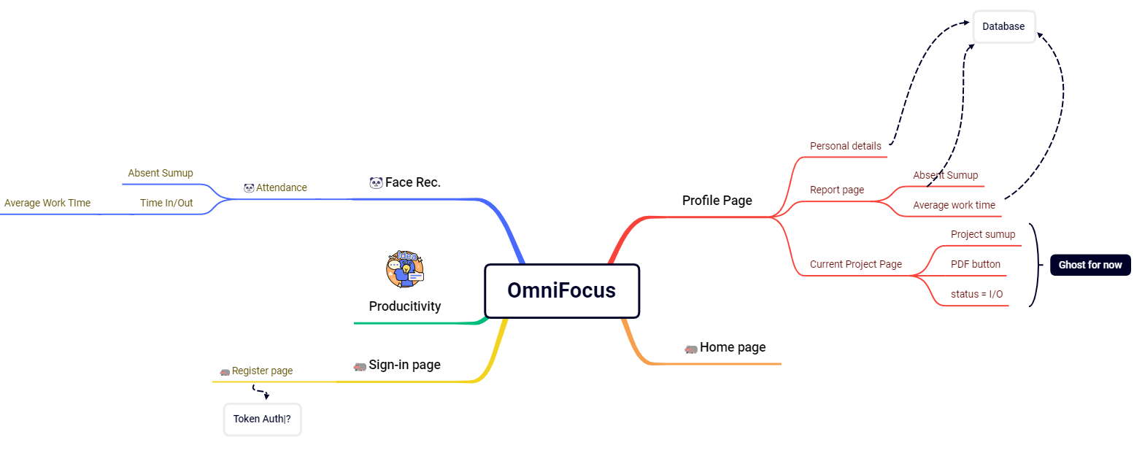
So, what is our product about?
We are One Stop solution for managing a company.
We Provide a swift workflow to simplify complex Operations, Ease access to employees’ records along with a productivity calculator, and Easy management of Projects.
We also provide the software linked with a camera for Attendance which is linked to our database.
Our Workflow so far
OMNIZENON

Slide 6

Face Recognition Attendance System
What does it do?
Camera linked with the Face Recognition System will be placed at the entry point of the company which will be used to store the attendance, time of arrival & departure of the employees in a Database.
These entries will be used in our Productivity Algorithm.
Moreover, Employees can keep track of their attendance through the company's site.
How does it do it?
Using OpenCV and face-recognition frameworks, We use image processing on the live video capture from the placed cameras.
The face in the image is matched with the available employee image history. If matched, an entry is made in the Database.
OMNIZENON

Slide 7
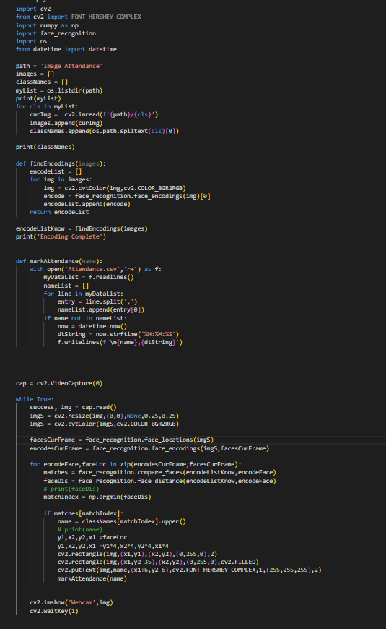
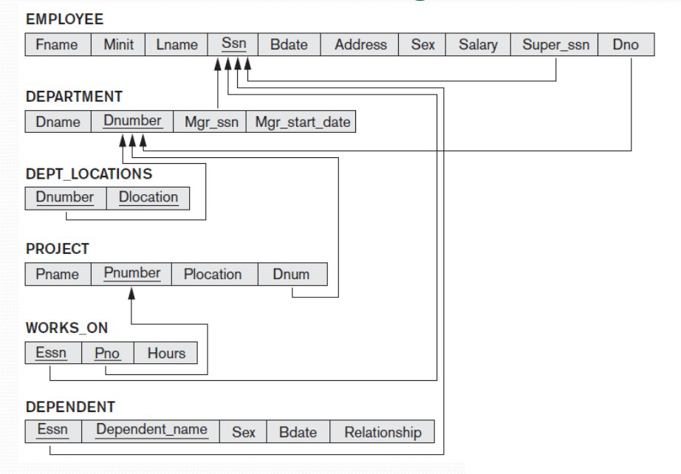
Face Recognition Attendance System
Glimpse of Code of Face Recognition
The Database Schema for our Project Management is this:
OMNIZENON

Slide 8
Productivity Calculator
Inputs - Divided into 3 main parts
Regularity
Project
Seniority
Absent records
Average Daily contact hours
Project Difficulty
Project Submission Time
1-10 score given by the reviewer of the specific project
Post of the employee
No. of employees working under a specific employee
Output
Productivity Index
between 1-10
OMNIZENON

Slide 9


Target Audience
Companies with a large workforce
NGOs
School & Educational Institute
They will greatly benefit from this system as it provides highly relevant data about each employee which can be analyzed and used to provide feedback in areas of improvement.
OMNIZENON

